Slide 1
The Electricity Year 2012
Diagram from the publication

Slide 2
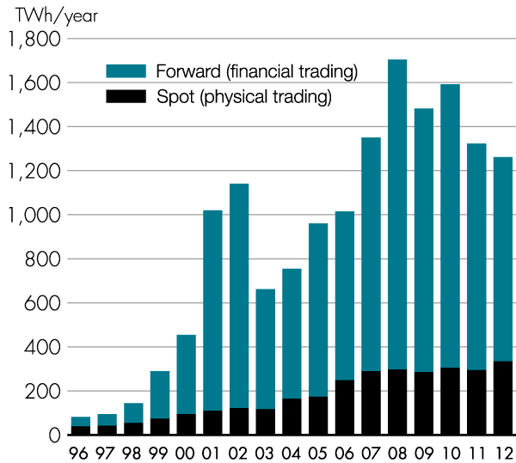
Trading on the spot and forward markets
Source: Nord Pool Spot

Slide 3
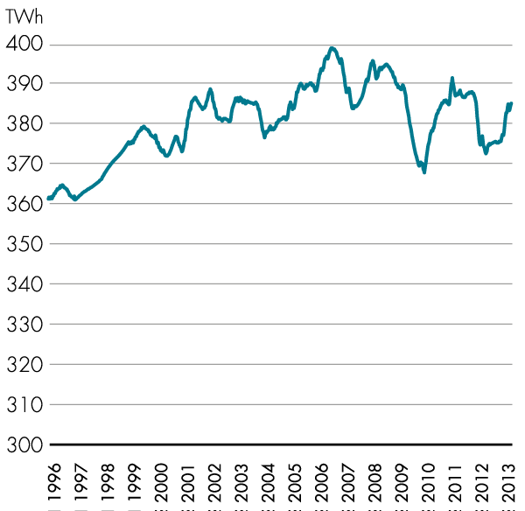
Electricity usage in the Nordic region since 1996, TWh
Source: Nord Pool Spot

Slide 4
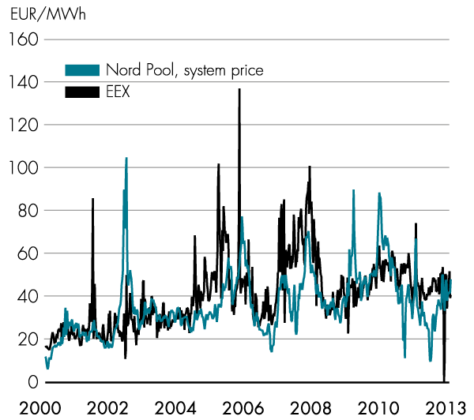
Electricity spot prices on Nord Pool Spot and EEX (German electricity price)
Sources: Nord Pool Spot, EEX

Slide 5
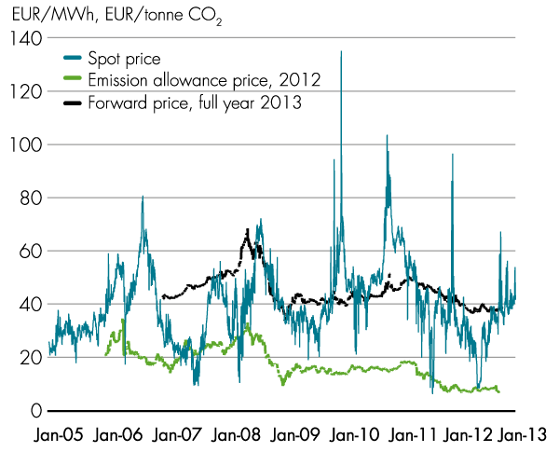
Electricity spot price, forward price and price of emission allowances
Source: Nord Pool Spot

Slide 6
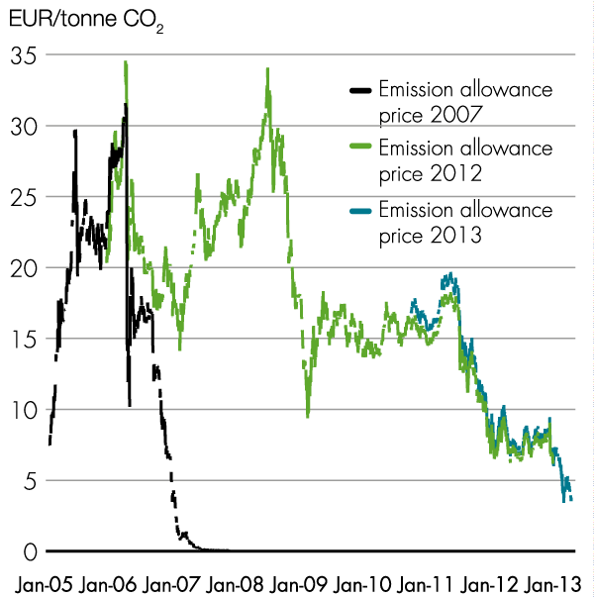
Price of emission allowances on NASDAQ OMX commodities
Source: Nord Pool Spot

Slide 7
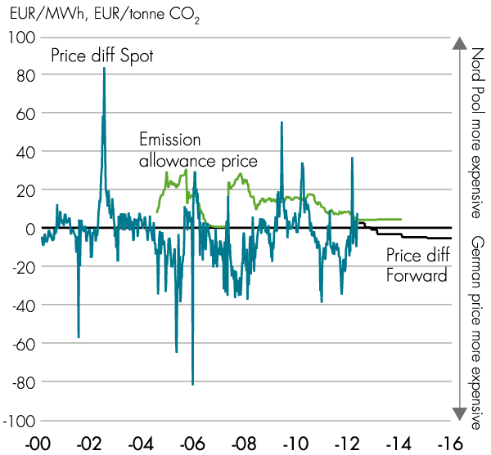
Price of emission allowances and price differences between the Nordic region and Germany
Sources: Nord Pool Spot, EEX

Slide 8
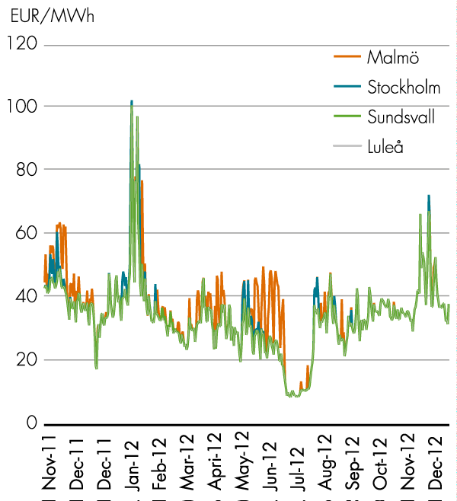
Hourly area prices in Sweden
Source: Nord Pool Spot

Slide 9
 | Installed capacity by bidding area on 1 january 2013, MWel
 |  | SE1 | SE2 | SE3 | SE4 | SE
 | Hydropower | 5,255 | 8,014 | 2,593 | 341 | 16,203
 | Nuclear power |  |  | 9,363 |  | 9,363
 | Wind power | 363 | 665 | 1,563 | 1,154 | 3,745
 | Other thermal power | 282 | 579 | 4,306 | 2,846 | 8,013
 | CHP, district heating system | 160 | 263 | 2,219 | 929 | 3,571
 | CHP, industrial | 122 | 316 | 602 | 335 | 1,375
 | Condensing power |  |  | 493 | 1,005 | 1,498
 | Gas turbines |  |  | 992 | 577 | 1,569
 | Solar power | n.d. | n.d. | n.d. | n.d. | 24
 | Other | 1 | 1 | 1 | 2 | 5
 | Entire country | 5,900 | 9,258 | 17,825 | 4,341 | 37,353
n.d.= no data available
Source: Swedenergy

Slide 10
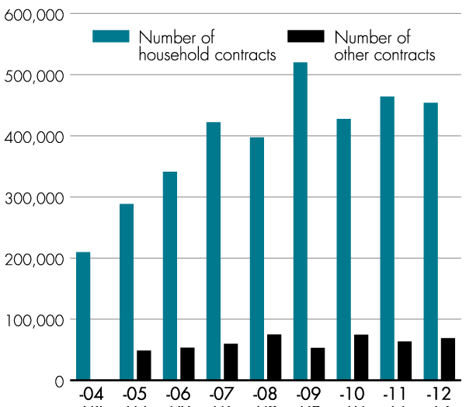
Number of supplier switches per year
Source: Statistics Sweden

Slide 11
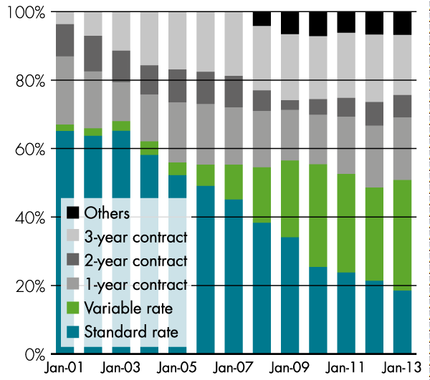
Customer mobility, January 2001–2013
Source: Statistics Sweden

Slide 12
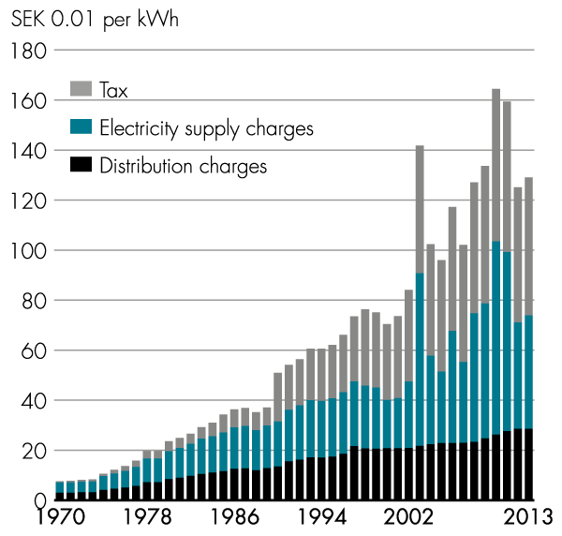
Breakdown of total electricity price for a single- family home with electrical heating and a variable rate contract, current prices, in January of each year
Sources: Swedish Energy Agency, Statistics Sweden

Slide 13
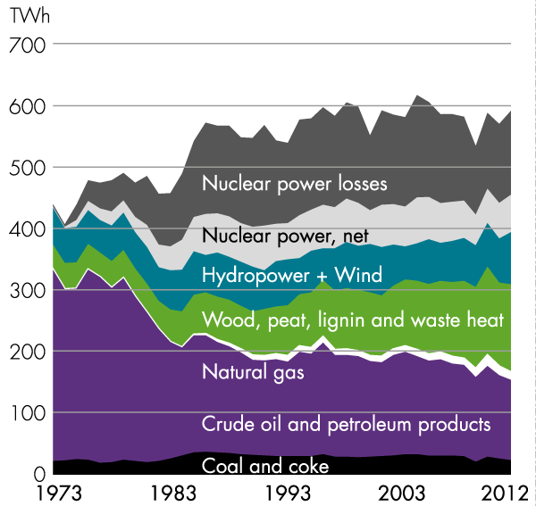
Total energy supply in Sweden 1973–2012
Source: Statistics Sweden

Slide 14
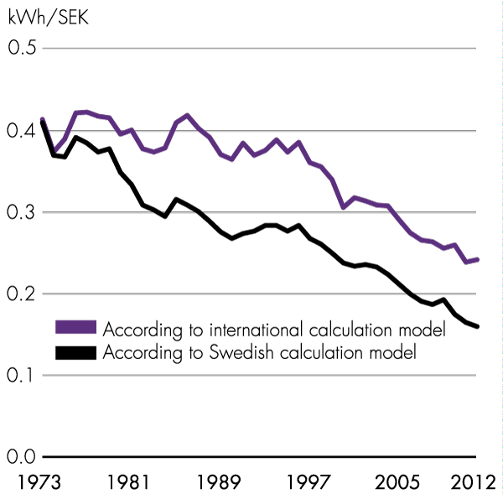
Total supplied energy in relation to GNP 1973–2012 (1995 prices)
Source: Statistics Sweden

Slide 15
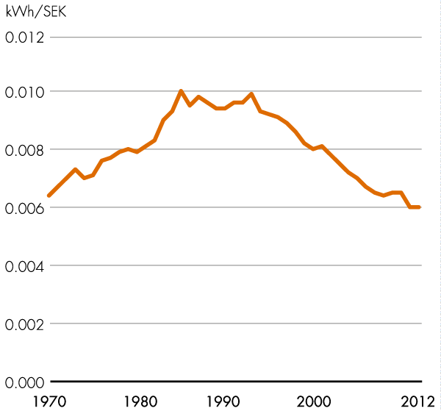
Electricity usage per GNP SEK 1970–2012 (1995 prices)
Source: Statistics Sweden

Slide 16
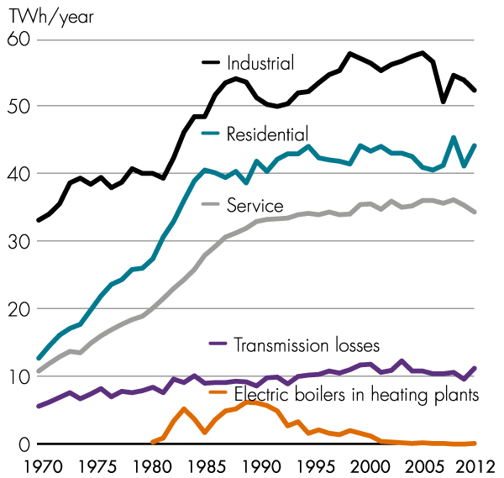
Breakdown of electricity usage by sector 1970–2012
Source: Statistics Sweden

Slide 17
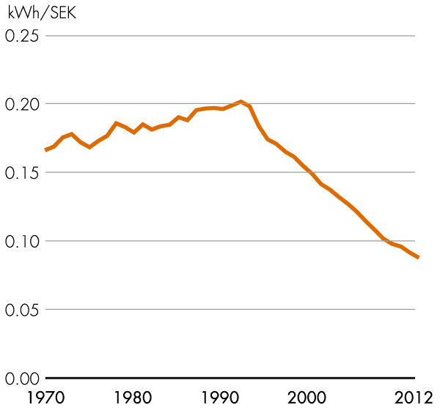
Industrial electricity usage in relation to value added 1970–2012 (1991 prices)
Source: Statistics Sweden

Slide 18
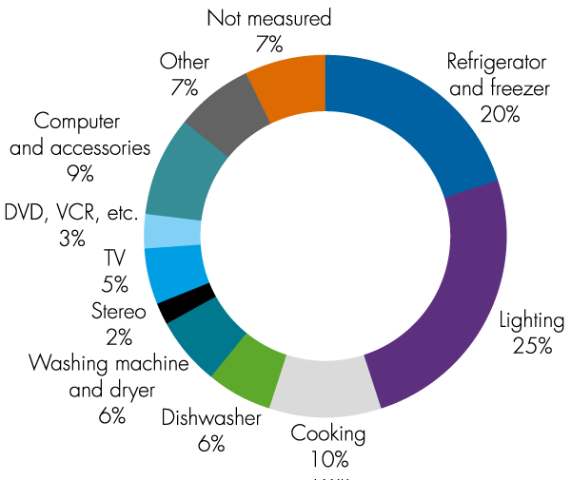
Household electricity usage by application (results for 2007)
Source: Swedish Energy Agency

Slide 19
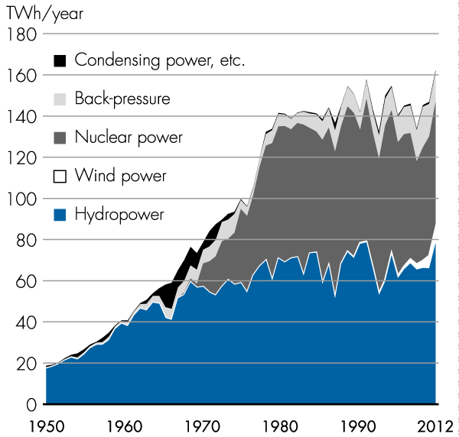
Total electricity supply in Sweden 1950–2012
Source: Swedenergy

Slide 20
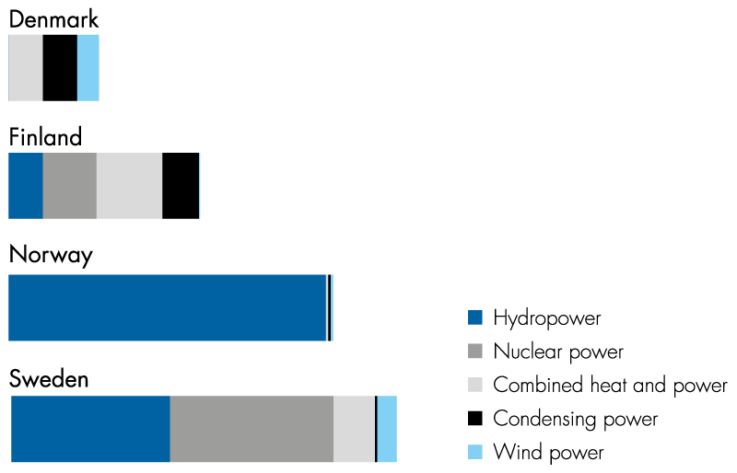
Normalized electricity production mix in the Nordic region
Source: Swedenergy

Slide 21
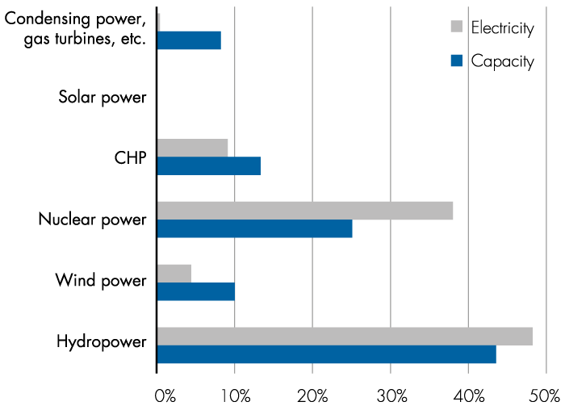
Breakdown of installed power capacity and annual electricity production for different power types 2012
Source: Swedenergy

Slide 22
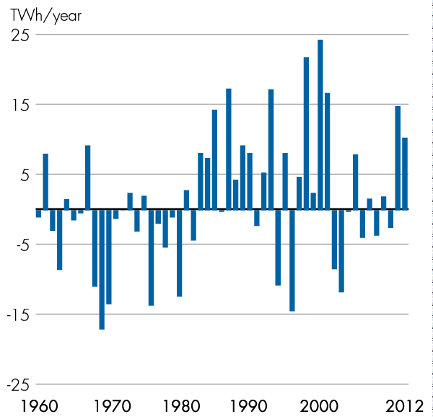
Runoff variations in relation to median value 1960–2012
Source: Swedenergy

Slide 23
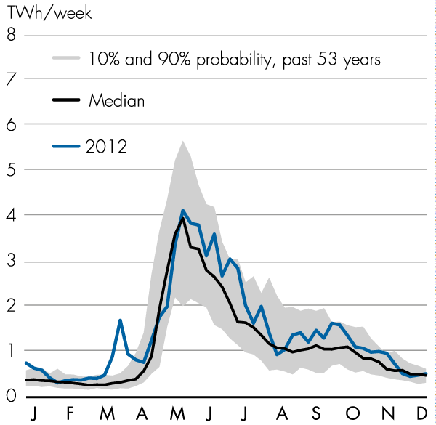
Runoff variations in the power-generating rivers
Source: Swedenergy

Slide 24
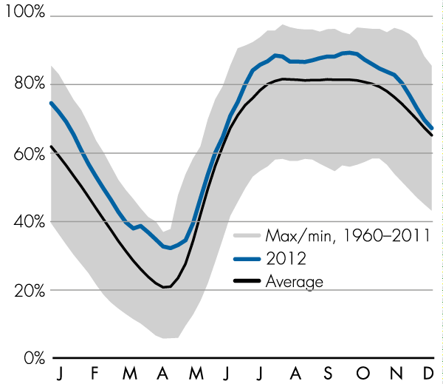
Storage levels in the regulating reservoirs
Source: Swedenergy

Slide 25
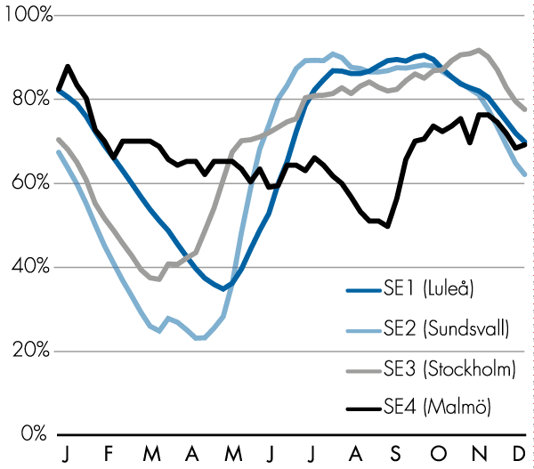
Storage levels in the regulating reservoirs in 2012 by bidding areas
Source: Swedenergy

Slide 26
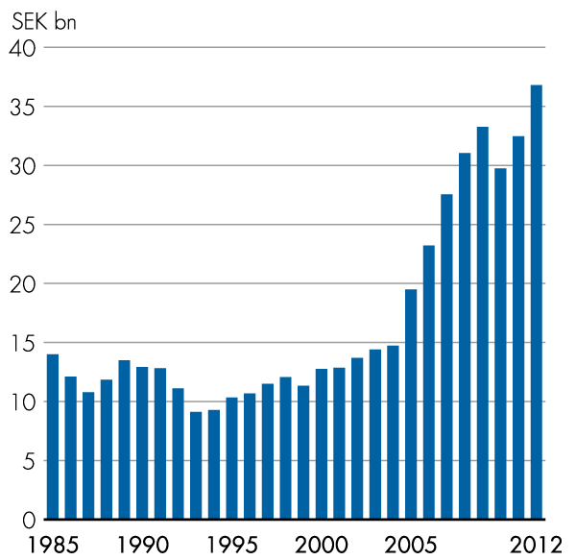
Energy industry gross investment in current prices
Source: Statistics Sweden

Slide 27
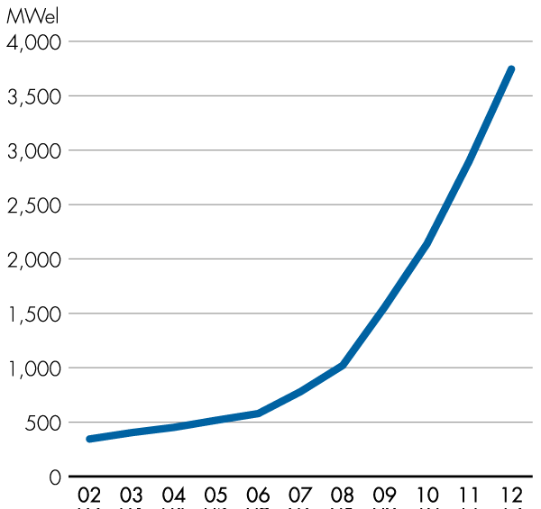
Installed wind power capacity in MW for the past 11 years
Source: Swedenergy

Slide 28
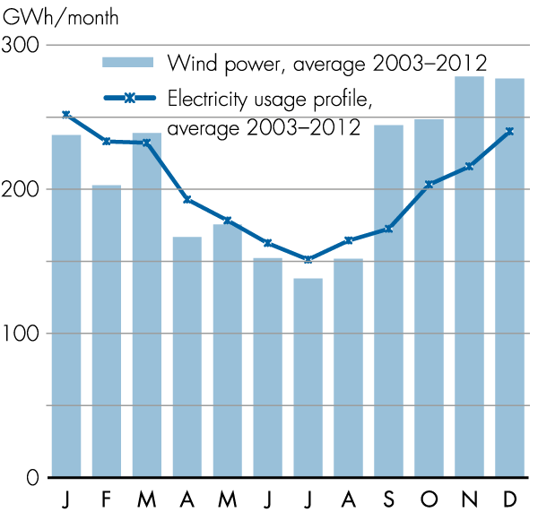
Average monthly generation of wind power for the past ten years in relation to the annual electricity usage profile
Source: Swedenergy

Slide 29
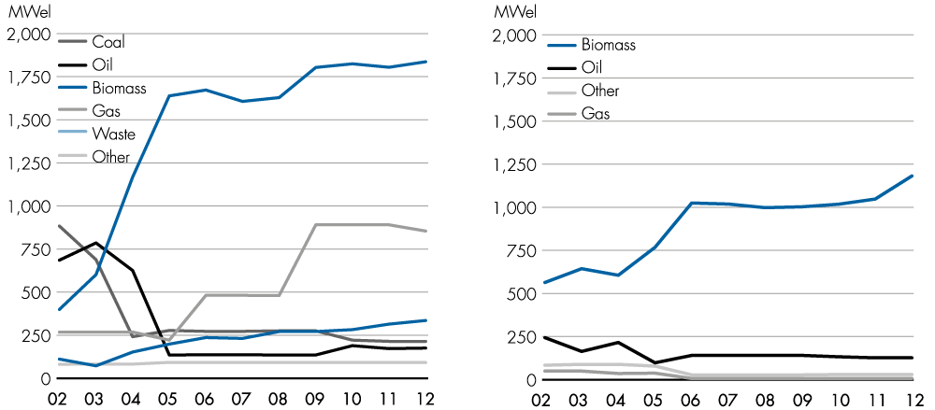
Installed power generation capacity in cogeneration district heating (at left) and industrial back-pressure plants 2002–2012
Source: Swedenergy

Slide 30
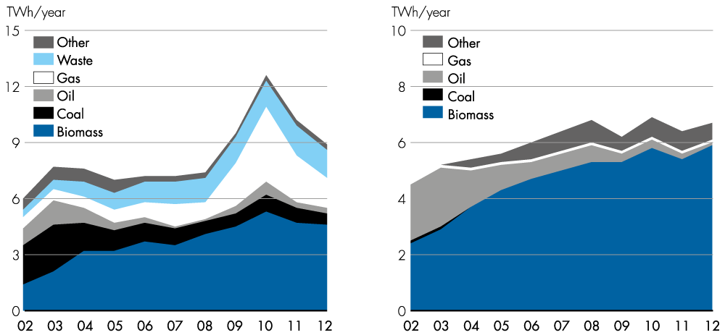
Power production by fuel type in cogeneration district heating and industrial back-pressure plants 2002–2012
Source: Swedenergy

Slide 31
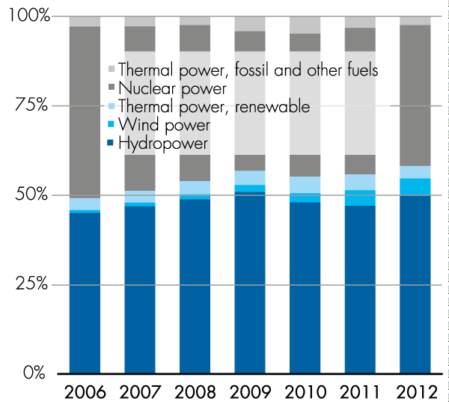
Development of renewable electricity generation 2006–2012
Source: Swedenergy

Slide 32
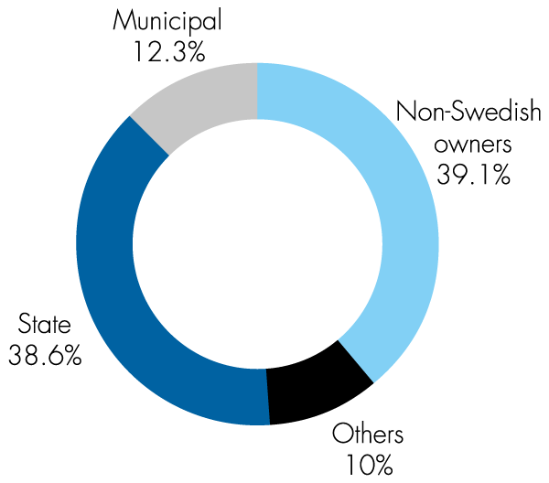
Ownership of generation capacity, values for 2012
Source: Swedenergy

Slide 33
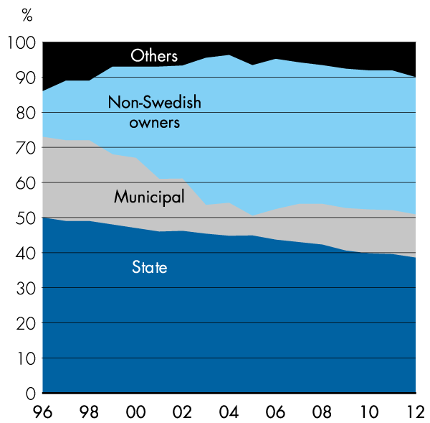
Changes in ownership of electricity generation 1996–2012
Source: Swedenergy

Slide 34
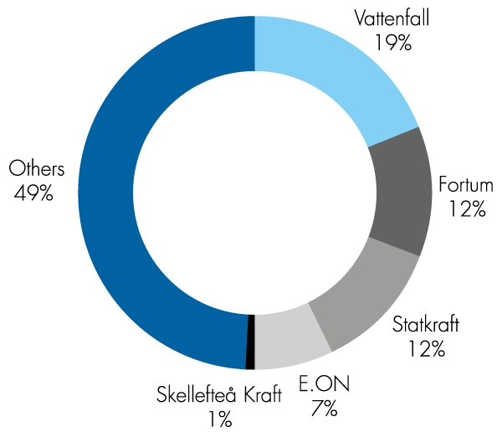
Five largest electricity producers in Sweden – production in Nordic region in 2012
Source: Swedenergy

Slide 35
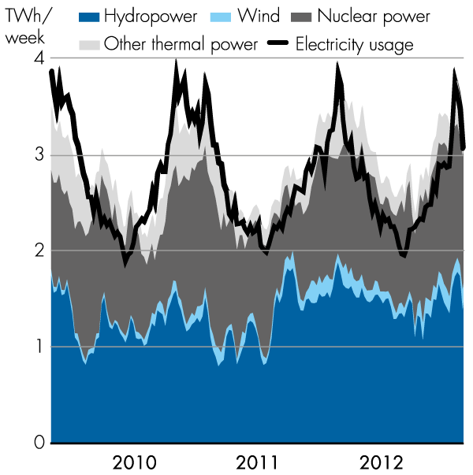
Electricity generation and usage in Sweden 2010–2012, TWh per week
Source: Swedenergy

Slide 36
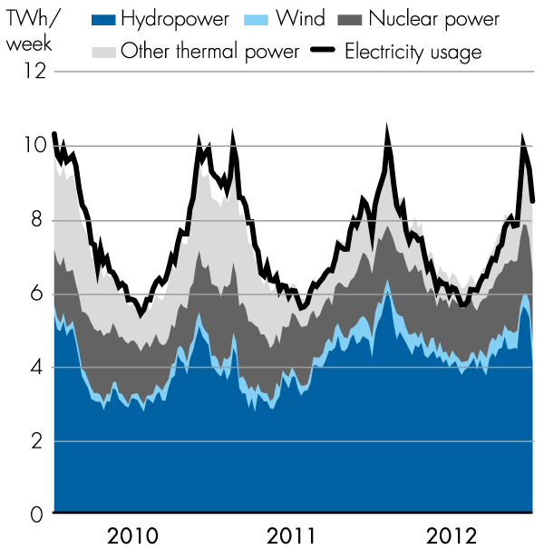
Electricity generation and usage in Nordic region 2010–2012, TWh per week
Source: Nord Pool

Slide 37
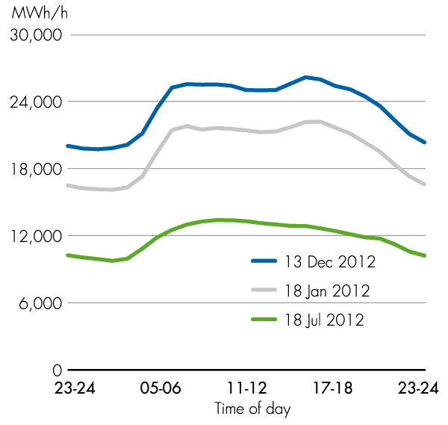
Hourly load profile for electricity usage with peak demand in 2012 and typical 24-hour period in winter and summer
Sources: Svenska Kraftnät, Swedenergy

Slide 38
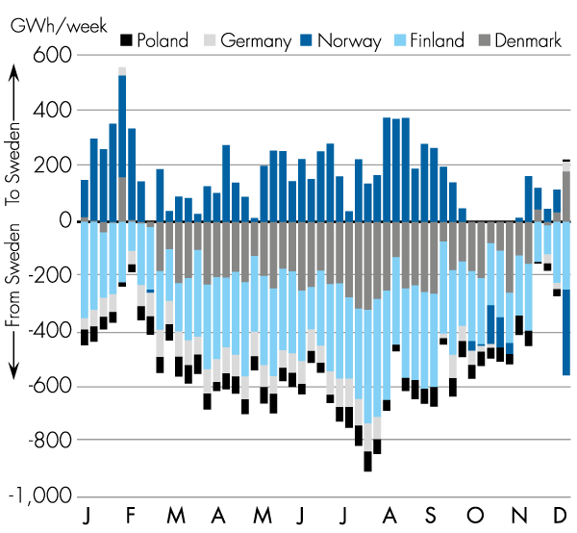
Net flow of electricity to and from Sweden per country in 2012, GWh per week
Source: Svenska Kraftnät

Slide 39
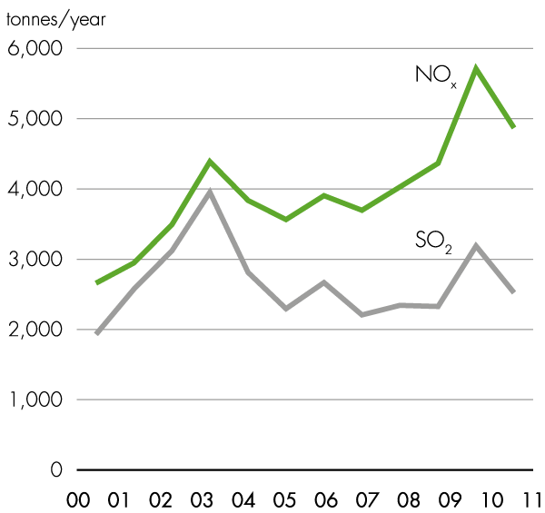
Airborne emissions of NO_{x} and SO₂ from electricity production 2000–2011, tonnes per year
Sources: Statistics Sweden, Swedish Environmental Protection Agency, Swedenergy

Slide 40
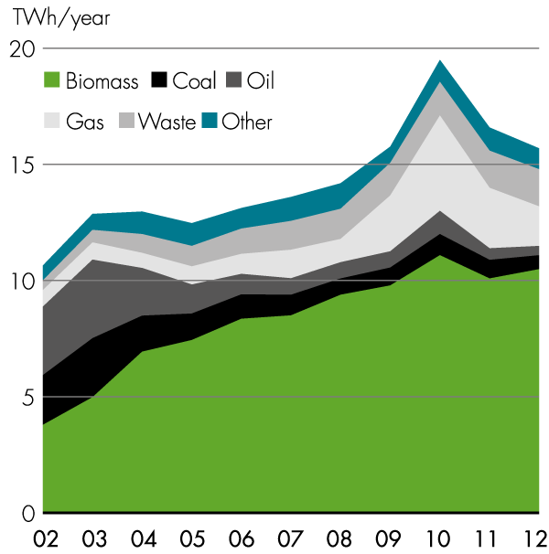
Electricity production in CHP plants, TWh
Source: Swedenergy

Slide 41
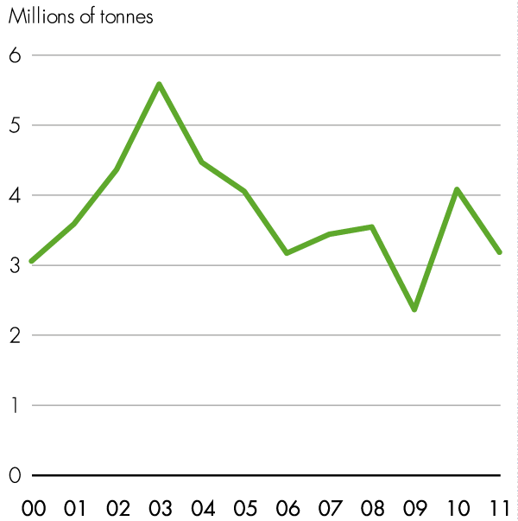
Airborne emissions of CO₂ from electricity production in 2000–2011
Sources: Statistics Sweden, Swedish Environmental Protection Agency, Swedenergy

Slide 42
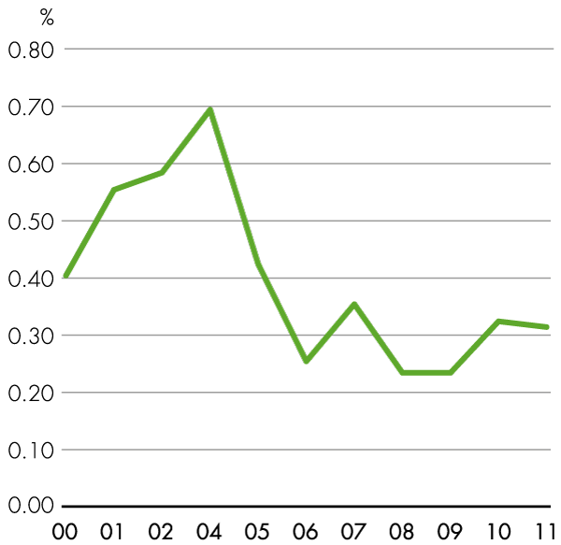
SF6 leakage (% of total usage in production and transmission operations)
Source: Swedenergy

Slide 43
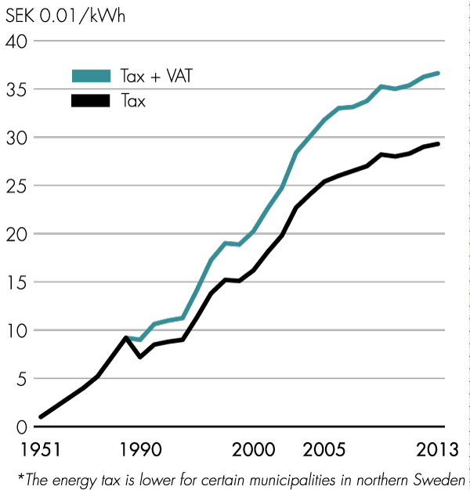
Development of electricity tax* (energy tax on electricity) since 1951
Sources: Statistics Sweden, Swedish Energy Agency

Slide 44
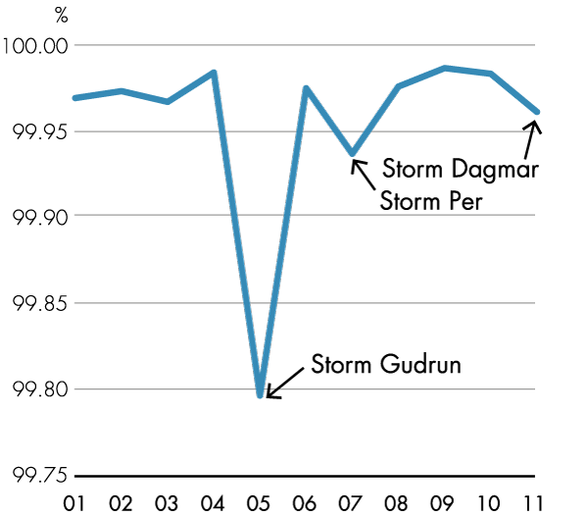
Delivery reliability in the Swedish electricity networks
Source: Swedenergy

