Slide 1
The Electricity Year 2014
Diagram from the publication

Slide 2
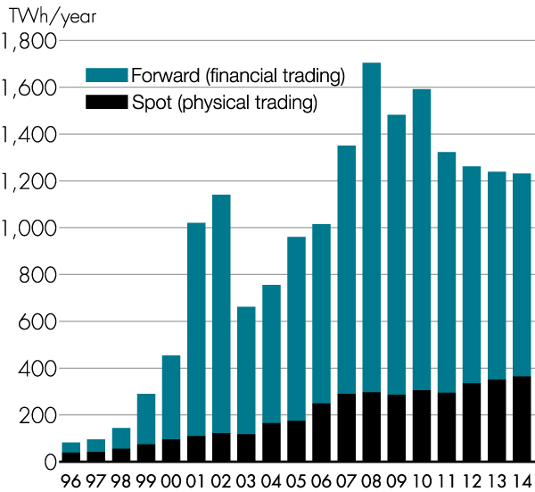
Trading on the spot and forward markets
Source: Nord Pool Spot

Slide 3
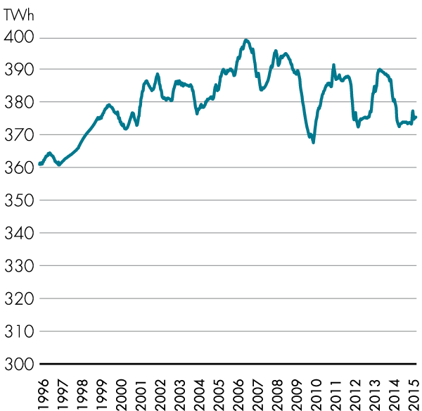
Electricity usage in the Nordic region since 1996, TWh
Source: Nord Pool Spot

Slide 4
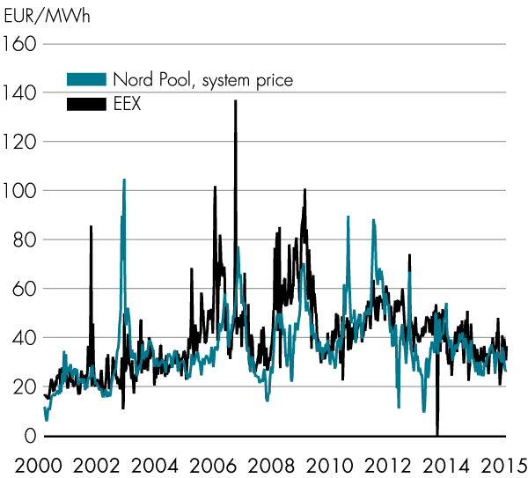
Electricity spot prices on Nord Pool Spot and EEX (German electricity price)
Sources: Nord Pool Spot, EEX

Slide 5
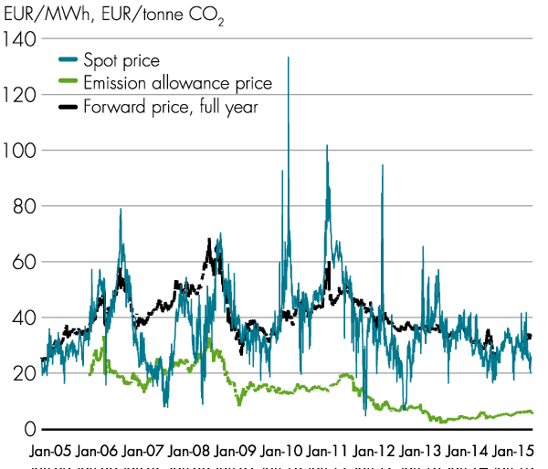
Electricity spot price, forward price and price of emission allowances
Source: Nord Pool Spot

Slide 6
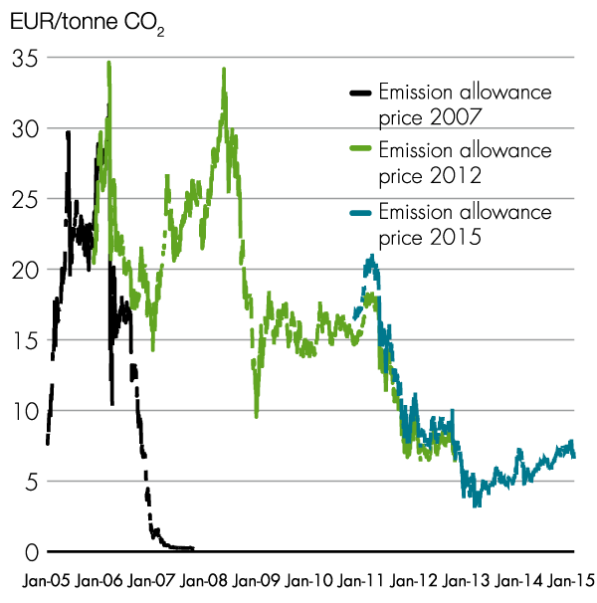
Price of emission allowances on NASDAQ OMX commodities
Source: Nord Pool Spot

Slide 7
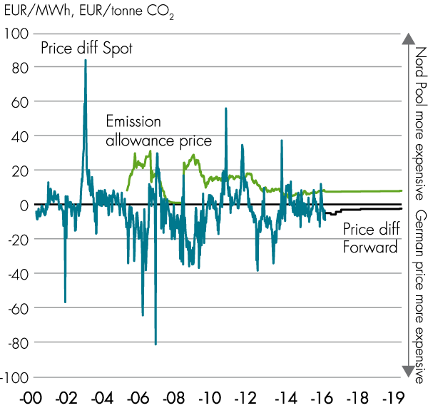
Price of emission allowances and price differences between the Nordic region and Germany
Sources: Nord Pool Spot, EEX

Slide 8
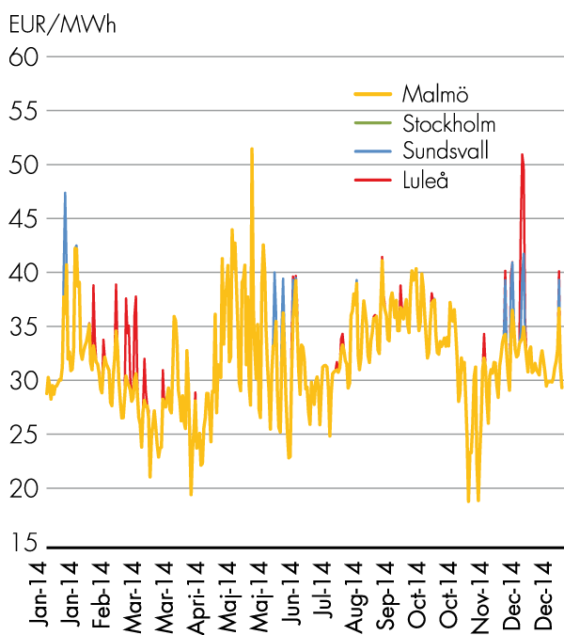
Hourly area prices in Sweden
Source: Nord Pool Spot

Slide 9
 | Installed capacity by bidding area on 1 january 2015, MWel
 |  | Luleå SE1 | Sundsvall SE2 | Stockholm SE3 | Malmö SE4 | Sverige SE
 | Hydropower | 5,176 | 8,040 | 2,591 | 348 | 16,155
 | Nuclear power |  |  | 9,528 |  | 9,528
 | Wind power | 478 | 1,467 | 1,986 | 1,489 | 5,420
 | Other thermal power | 282 | 586 | 4,625 | 2,868 | 8,361
 | CHP, district heating system | 160 | 270 | 2 300 | 951 | 3,681
 | CHP, industrial | 122 | 316 | 602 | 335 | 1,375
 | Condensing power |  |  | 743 | 1,005 | 1,748
 | Gas turbines |  |  | 980 | 577 | 1,557
 | Solar power | n.d | n.d | n.d | n.d | 79
 | Other | 1 | 1 | 1 | 2 | 6
 | Entire country | 5,937 | 10,094 | 18,731 | 4,707 | 39,549
n.d.= no data available
Source: Swedenergy

Slide 10
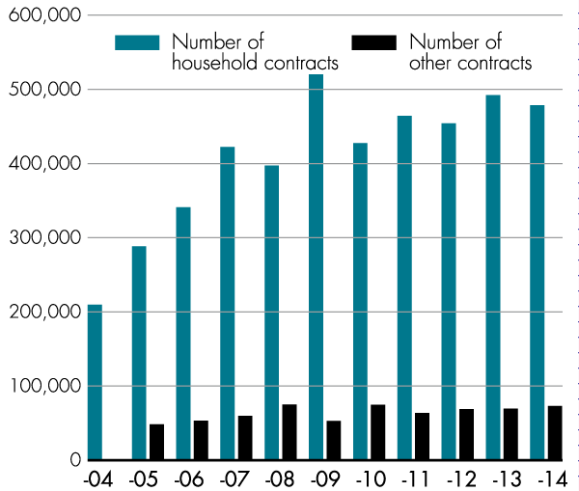
Number of supplier switches per year
Source: Statistics Sweden

Slide 11
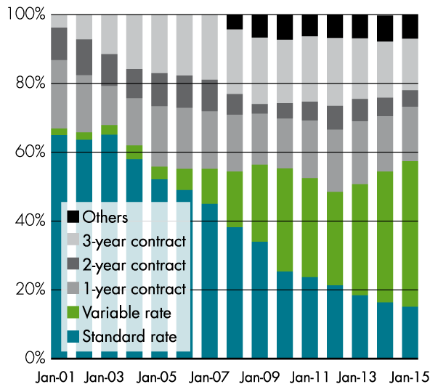
Customer mobility, January 2001–2015
Source: Statistics Sweden

Slide 12
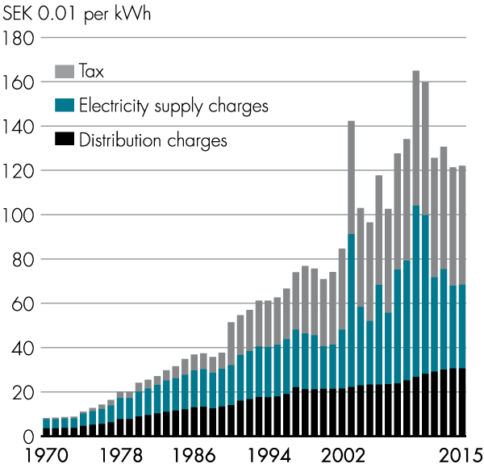
Breakdown of total electricity price for a single- family home with electrical heating and a variable rate contract, current prices, in January of each year
Sources: Swedish Energy Agency, Statistics Sweden

Slide 13
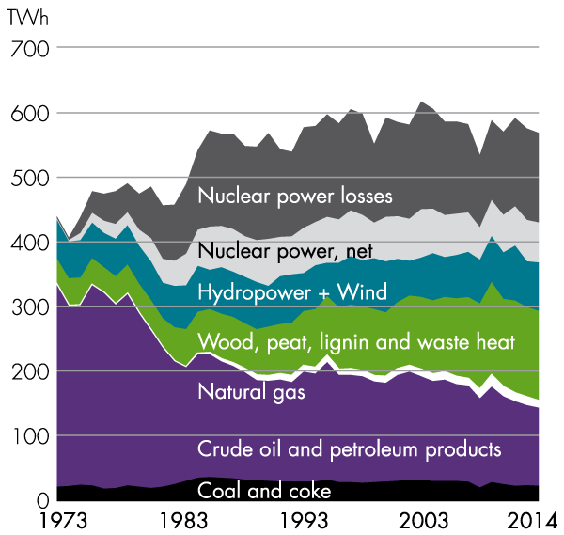
Total energy supply in Sweden 1973–2014
Source: Statistics Sweden

Slide 14
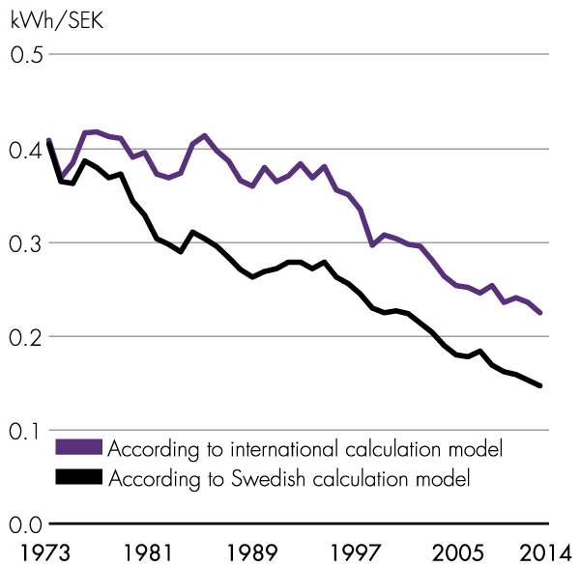
Total supplied energy in relation to GNP 1973–2014 (1995 prices)
Source: Statistics Sweden

Slide 15
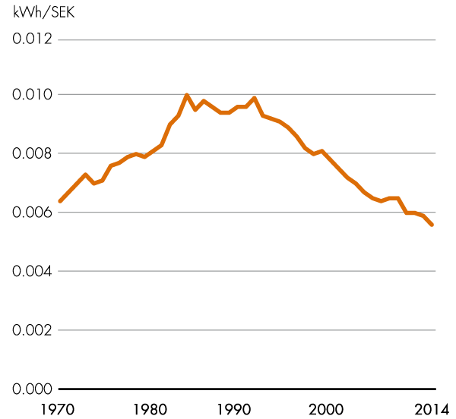
Electricity usage per GNP SEK 1970–2014 (1995 prices)
Source: Statistics Sweden

Slide 16
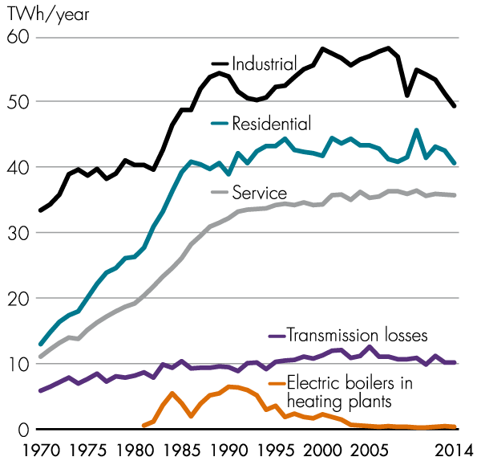
Breakdown of electricity usage by sector 1970–2014
Source: Statistics Sweden

Slide 17
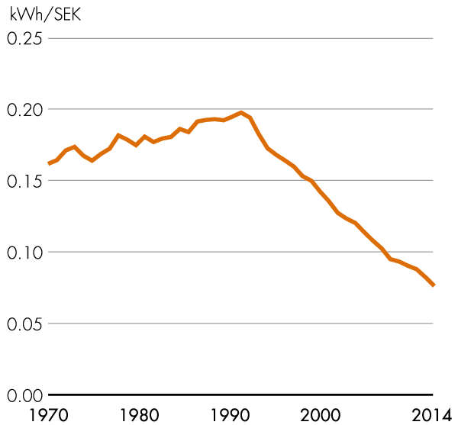
Industrial electricity usage in relation to value added 1970–2014 (1991 prices)
Source: Statistics Sweden

Slide 18
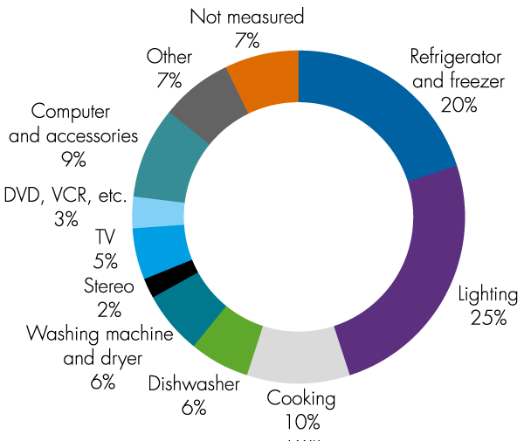
Household electricity usage by application (results for 2007)
Source: Swedish Energy Agency

Slide 19
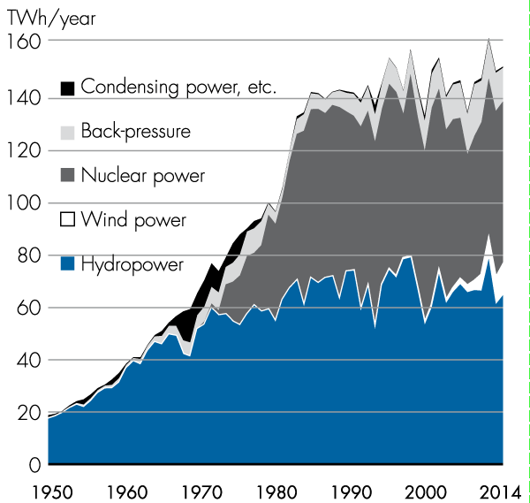
Total electricity supply in Sweden 1950–2014
Source: Swedenergy

Slide 20
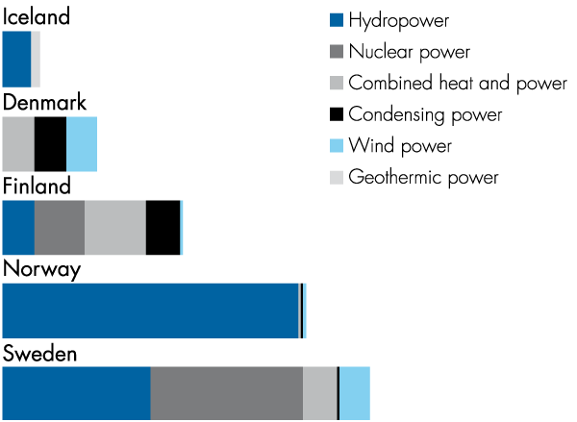
Normalized electricity production mix in the Nordic region
Source: Swedenergy

Slide 21
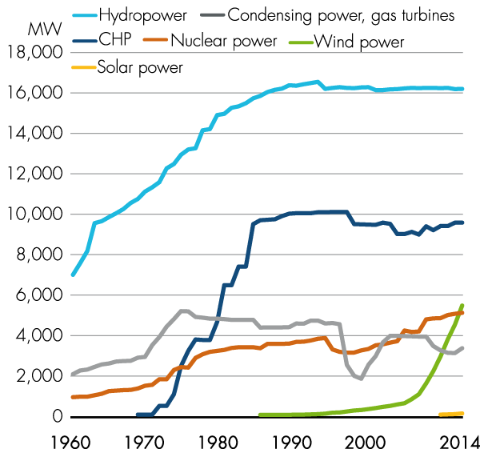
Development of different power types in Sweden (capacity)
Source: Swedenergy

Slide 22
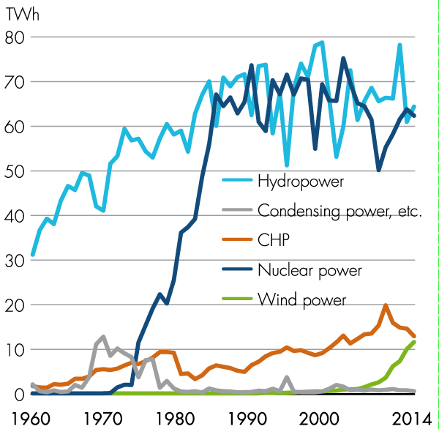
Development of different power types in Sweden (electricity generation)
Source: Swedenergy

Slide 23
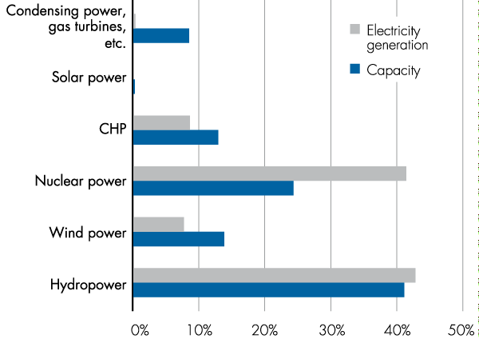
Breakdown of installed power capacity and annual electricity production for different power types 2014
Source: Swedenergy

Slide 24
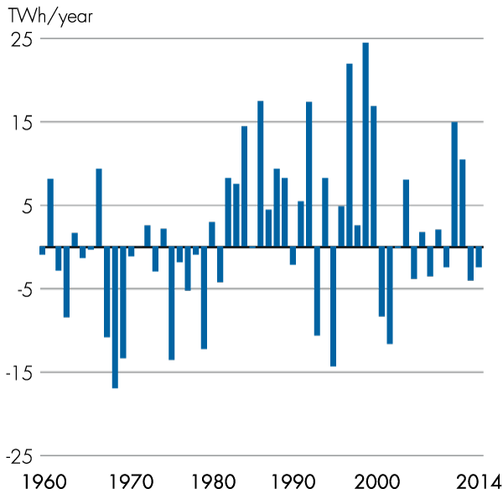
Runoff variations in relation to median value 1960–2014
Source: Swedenergy

Slide 25
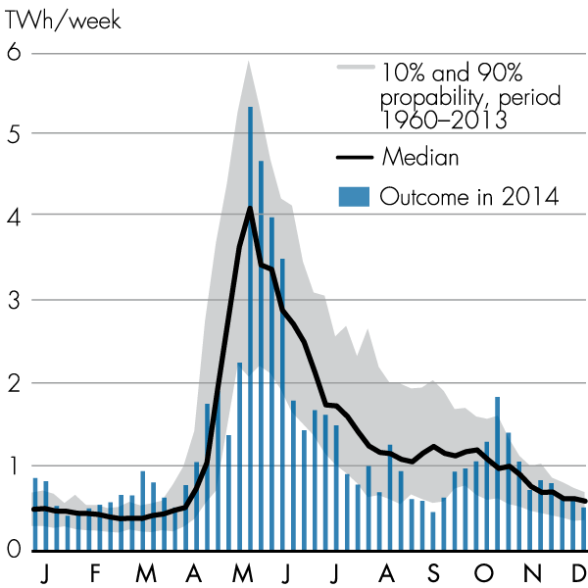
Runoff variations in the power-generating rivers
Source: Swedenergy

Slide 26
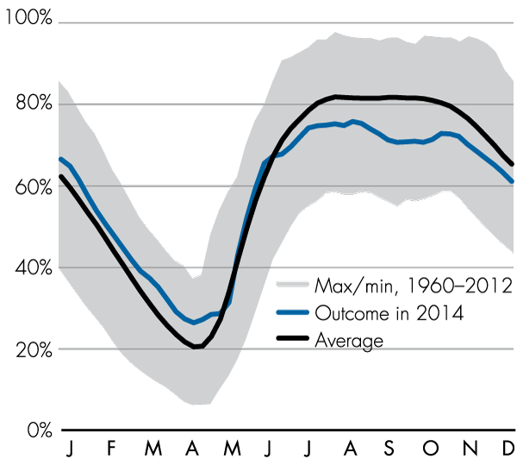
Storage levels in the regulating reservoirs
Source: Swedenergy

Slide 27
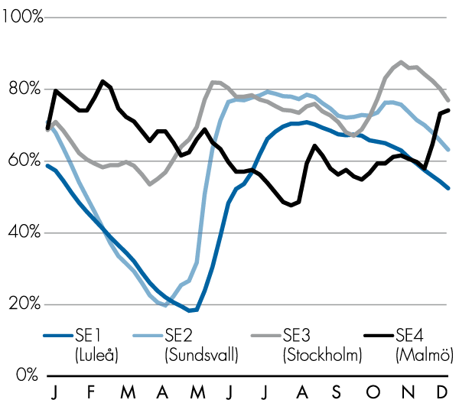
Storage levels in the regulating reservoirs in 2014 by bidding areas
Source: Swedenergy

Slide 28
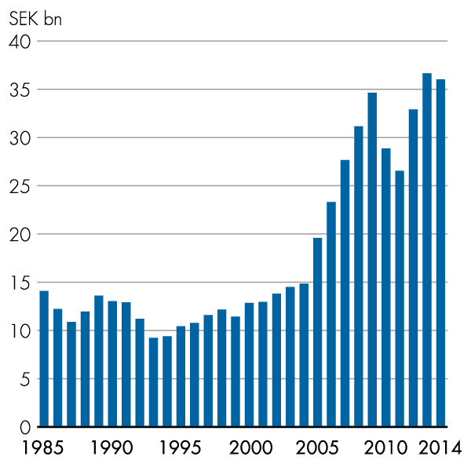
Energy industry gross investment in current prices
Source: Statistics Sweden

Slide 29
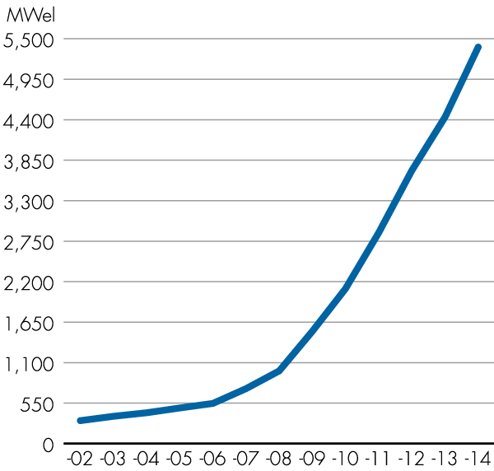
Installed wind power capacity in MW for the past 13 years
Source: Swedenergy

Slide 30
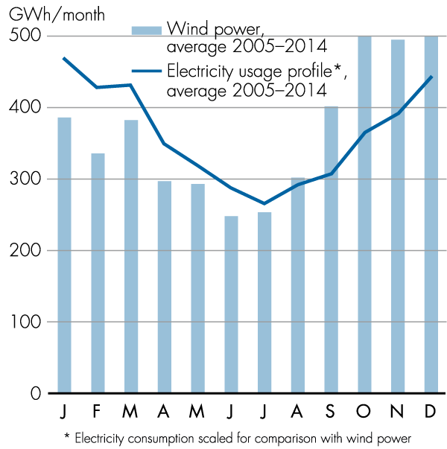
Average monthly generation of wind power for the past ten years in relation to the annual electricity usage profile
Source: Swedenergy

Slide 31
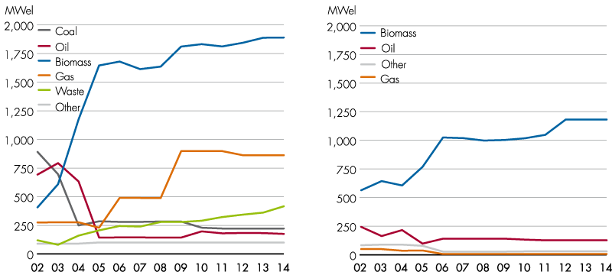
Installed power generation capacity in cogeneration district heating (at left) and industrial back-pressure plants 2002–2014
Source: Swedenergy

Slide 32
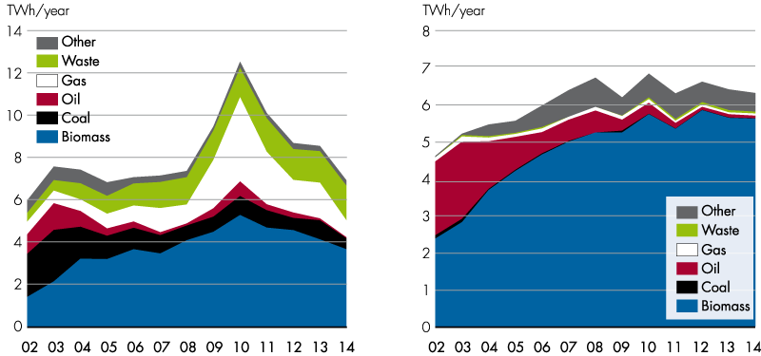
Power production by fuel type in cogeneration district heating and industrial back-pressure plants 2002–2014
Source: Swedenergy

Slide 33
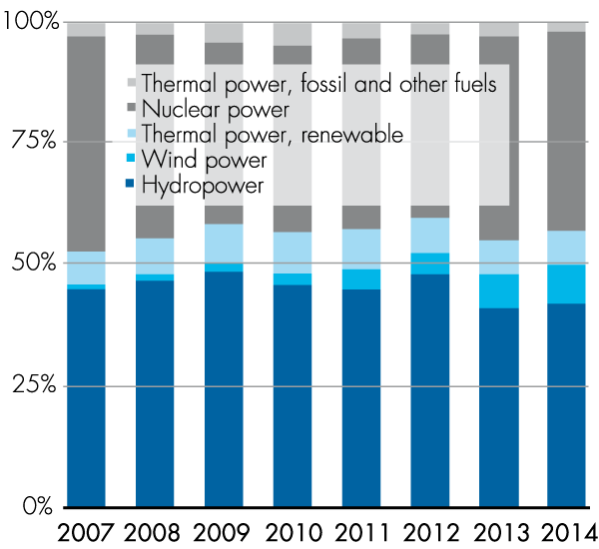
Development of renewable electricity generation 2007–2014
Source: Swedenergy

Slide 34
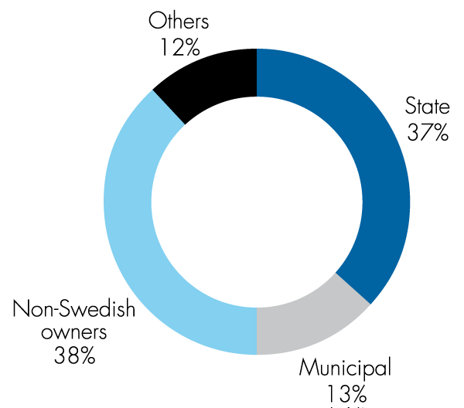
Ownership of generation capacity, values for 2014
Source: Swedenergy

Slide 35
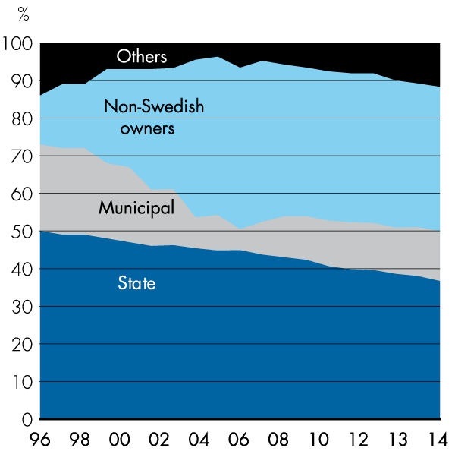
Changes in ownership of electricity generation 1996–2014
Source: Swedenergy

Slide 36
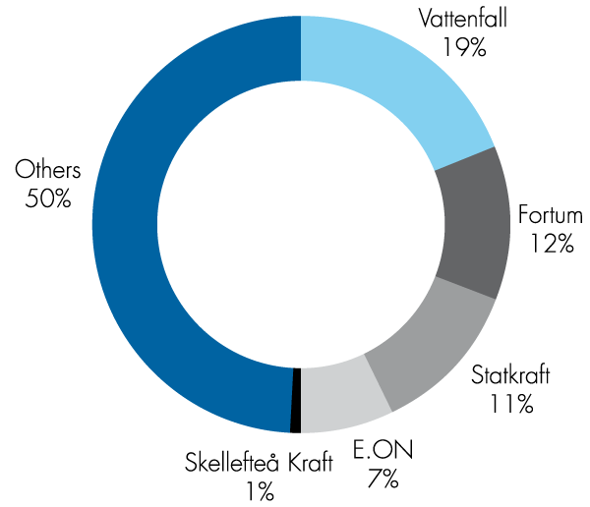
Five largest electricity producers in Sweden – production in Nordic region in 2014
Source: Swedenergy

Slide 37
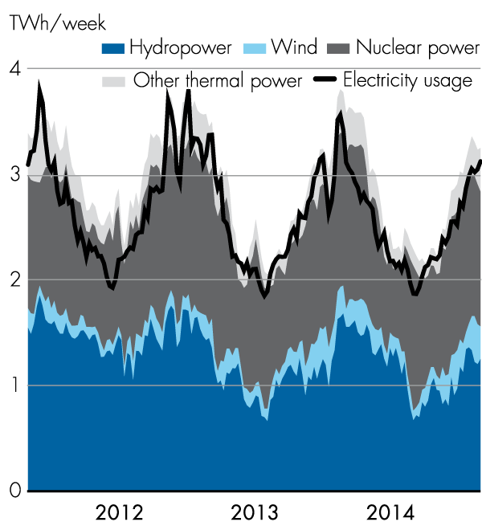
Electricity generation and usage in Sweden 2012–2014, TWh per week
Source: Swedenergy

Slide 38
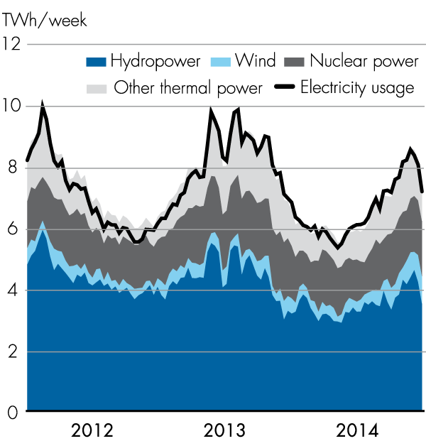
Electricity generation and usage in Nordic region 2012–2014, TWh per week
Source: Nord Pool Spot

Slide 39
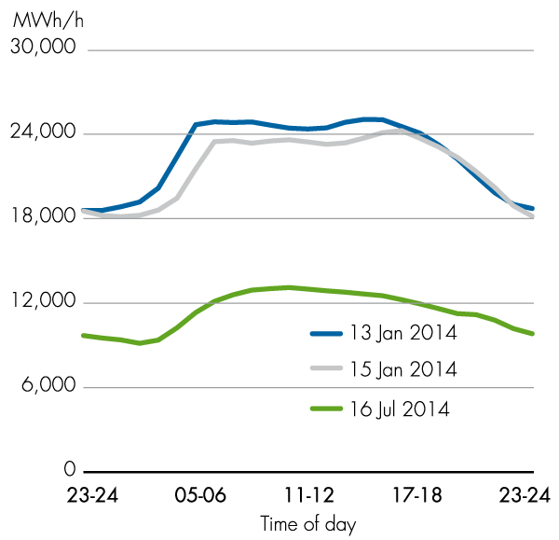
Hourly load profile for electricity usage with peak demand in 2014 and typical 24-hour period in winter and summer
Sources: Svenska kraftnät, Swedenergy

Slide 40
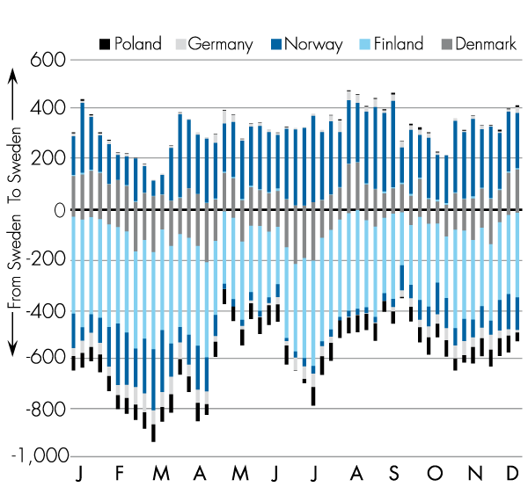
Net flow of electricity to and from Sweden per country in 2014, GWh per week
Source: Svenska kraftnät

Slide 41
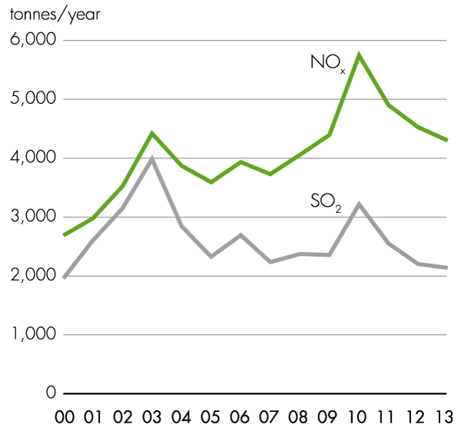
Airborne emissions of NO_{x} and SO₂ from electricity production 2000−2013, tonnes per year
Sources: Statistics Sweden, Swedish Environmental Protection Agency, Swedenergy

Slide 42
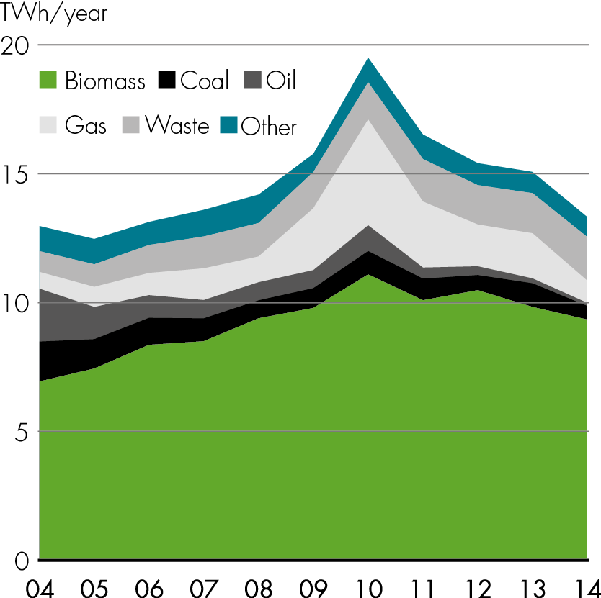
Electricity production in CHP plants, TWh/year
Source: Swedenergy

Slide 43
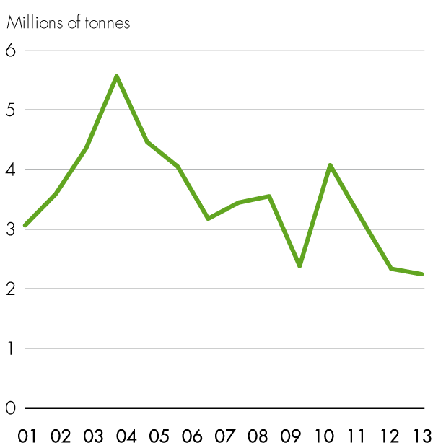
Airborne emissions of CO₂ from electricity production in 2001−2013
Sources: Statistics Sweden, Swedish Environmental Protection Agency, Swedenergy

Slide 44
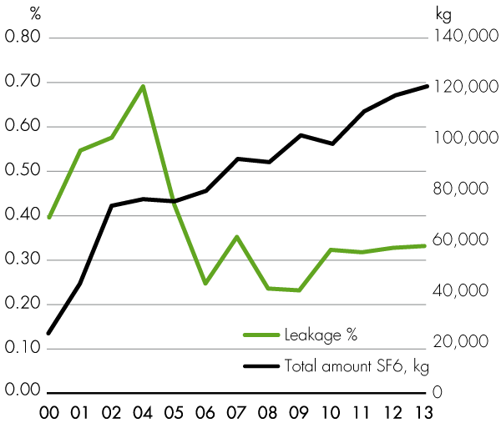
Amount of SF6 and SF6 leakage (% of total usage) in production and transmission operations
Source: Swedenergy

Slide 45
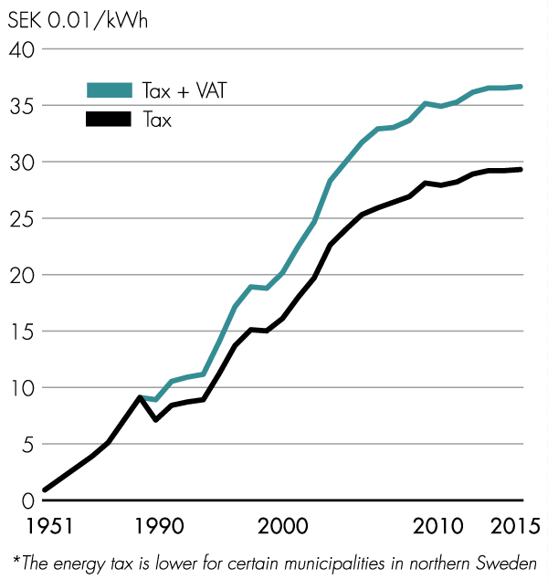
Development of electricity tax (energy tax on electricity) since 1951*
Sources: Statistics Sweden, Swedish Energy Agency

Slide 46
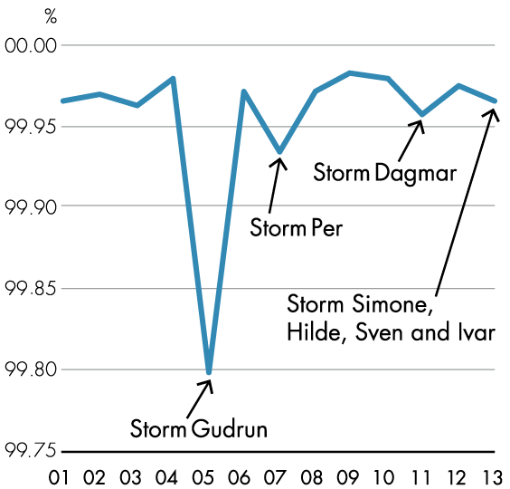
Continuity of supply in the Swedish electricity networks
Source: Swedenergy

